Slide 1
Data Science
Module Name: Deep Learning

Slide 2

Deep Learning
Chapters
Introduction to Deep Learning
Introduction to Linear Algebra
Artificial Neural Networks
Convolutional Neural Networks
Transfer Learning
Computer Vision
Natural Language processing
Recurrent Neural Networks

Slide 3
Chapter 1
Introduction to Deep Learning and Neural Networks

Slide 4
1. Introduction to Deep Learning and Neural Networks
What is Deep Learning?
It is a subset of machine learning, which is a type of artificial intelligence (AI) that involves training algorithms to make predictions or decisions based on input data.
Deep learning is specifically characterized by the use of neural networks that have multiple layers, allowing the algorithm to learn hierarchical representations of the input data.
Applications of Deep Learning:
Image recognition
Natural language processing
Autonomous driving and more

Slide 5
1. Introduction to Deep Learning and Neural Networks
What is Deep Learning?
It has proven to be particularly effective in tasks where traditional machine learning methods have struggled, such as those involving unstructured or high-dimensional data.
Deep learning algorithm uses a process called backpropagation to adjust the weights of the neural network in order to improve its performance on a given task.
The more layers a neural network has, the more complex patterns it can learn to recognize in the input data.

Slide 6
1. Introduction to Deep Learning and Neural Networks
Deep Learning Benefits
Improved accuracy:
Deep learning algorithms can achieve higher levels of accuracy than traditional machine learning algorithms in a wide range of tasks.
Automated feature engineering:
In traditional machine learning, feature engineering is often done manually.
In deep learning, the algorithm can automatically learn relevant features from the input data, saving time and effort.

Slide 7
1. Introduction to Deep Learning and Neural Networks
Deep Learning Benefits
Ability to handle big data:
Deep learning algorithms are well-suited for handling large volumes of data, including unstructured data such as images, audio, and text.
Flexibility:
Deep learning algorithms are highly flexible and can be applied to a wide range of tasks, from computer vision and speech recognition to natural language processing and autonomous driving.

Slide 8
1. Introduction to Deep Learning and Neural Networks
Deep Learning Benefits
Continuous learning:
Deep learning algorithms can be trained on new data over time, allowing them to continuously improve their performance on a given task.
Reduced need for human intervention:
Deep learning algorithms can often operate with little or no human intervention once they have been trained, making them useful in applications where real-time decision-making is required.

Slide 9
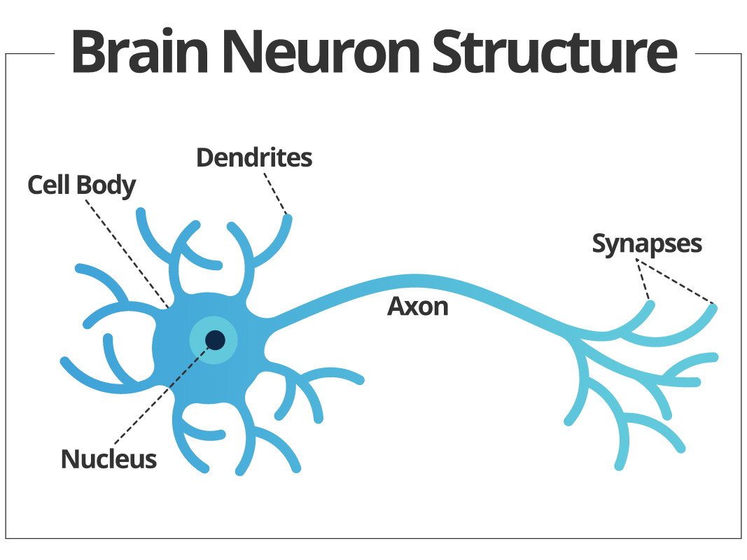
1. Introduction to Deep Learning and Neural Networks
Source: https://www.smartsheet.com/sites/default/files/IC-Brain-Neuron-Structure.svg

Slide 10
1. Introduction to Deep Learning and Neural Networks
Brain Neuron
A typical neuron consists of three main parts:
Cell body (or soma)
Dendrites
Axon
The cell body contains the nucleus and other organelles that carry out basic cellular functions.
The dendrites are thin, branching extensions of the cell body that receive input from other neurons.
The axon is a long, thin extension that transmits electrical signals away from the cell body to other neurons.

Slide 11
1. Introduction to Deep Learning and Neural Networks
Brain Neuron
When a neuron is stimulated, an electrical signal called an action potential travels down the axon and causes the release of neurotransmitters from the terminal branches of the axon.
These neurotransmitters diffuse across the synapse and bind to receptors on the dendrites of the receiving neuron, causing it to generate its own action potential.
The structure and function of biological neurons have inspired the development of artificial neural networks in machine learning.

Slide 12
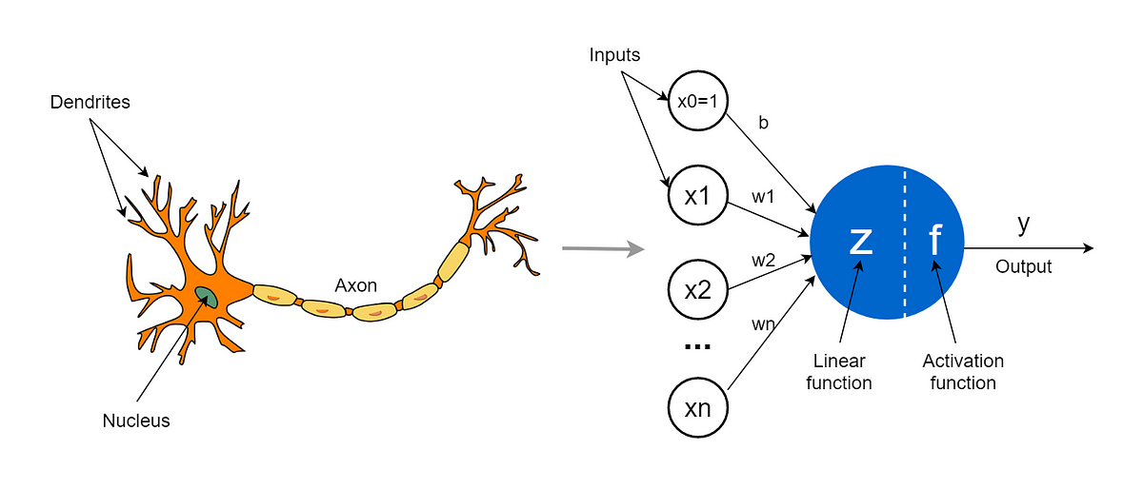
1. Introduction to Deep Learning and Neural Networks
Artificial Neuron
Source: https://miro.medium.com/v2/resize:fit:1200/1*hkYlTODpjJgo32DoCOWN5w.png

Slide 13
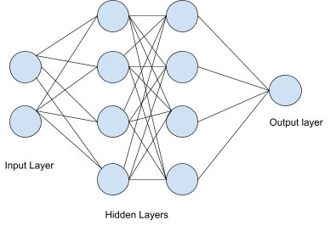
1. Introduction to Deep Learning and Neural Networks
Neural Network
Spurce: https://www.hotelmize.com/wp-content/uploads/2021/04/How-does-a-neural-network-works.png

Slide 14
Chapter 2
Introduction to Linear Algebra

Slide 15
2. Introduction to Linear Algebra
What is linear algebra?
It is a branch of mathematics that deals with the study of linear equations, linear transformations, and vector spaces.
It involves the study of properties of matrices, determinants, vectors, and linear equations and their applications to different fields such as physics, engineering, computer science, and economics.
The main focus of linear algebra is to find solutions to systems of linear equations, which are used to represent a wide range of real-world problems.

Slide 16
2. Introduction to Linear Algebra
What is linear algebra?
Linear algebra also provides tools for analyzing and manipulating data sets, which is essential in data analysis and machine learning.
It has many applications in modern technology and is an essential tool for solving complex problems in engineering and science.

Slide 17
2. Introduction to Linear Algebra
Scalar
Scalar is a single number that is used to scale a vector or a matrix.
A scalar can be any real or complex number, and it can be positive, negative, or zero
When a scalar is multiplied with a vector, it results in a new vector that is parallel to the original vector, but its magnitude is either increased or decreased
If the scalar is negative, the resulting vector is in the opposite direction of the original vector.

Slide 18
2. Introduction to Linear Algebra
Scalar
When a scalar is multiplied with a matrix, it results in a new matrix where each element of the original matrix is multiplied by the scalar. It is one of the fundamental operations in linear algebra.
Scalars are essential in linear algebra because they allow us to manipulate vectors and matrices and perform various operations on them, such as:
Adding
Subtracting
Multiplying

Slide 19

2. Introduction to Linear Algebra
Vectors
Vector is defined by its components, which are a set of n real or complex numbers that represent the magnitude of the vector in each dimension
In simple it is a collection of scalars as follows:
$\begin{matrix}[10 & 20 & 30]\end{matrix}$ It is called row vector
$\begin{matrix}[10 \\ 20 \\ 30]\end{matrix}$ It is called column vector

Slide 20
2. Introduction to Linear Algebra
Vectors
We can perform scalar operations such as addition, subtraction and more, the result vector will have same number of scalars
We can perform vector operations such as addition, subtraction and more, the result vector will have same number of scalars of vectors present in the operation
In linear algebra, vectors are used to represent many types of data, such as position, velocity, force, and acceleration, among others.

Slide 21
2. Introduction to Linear Algebra
Matrix
Matrix is a rectangular array of numbers, symbols, or expressions arranged in rows and columns.
Matrices are denoted by boldface capital letters, such as X, Y, Z and etc
The number of rows and columns of a matrix is called its dimensions. For example, a matrix with m rows and n columns is said to be an m×n matrix.
The elements of a matrix are typically denoted by a subscript notation, such as Aij, where i denotes the row number and j denotes the column number.

Slide 22
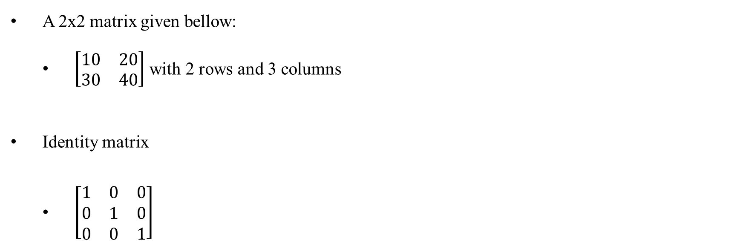
2. Introduction to Linear Algebra
Matrix
A 2x2 matrix given bellow:
$\left[\begin{matrix}10 & 20 \\ 30 & 40\end{matrix}\right]$ with 2 rows and 3 columns
Identity matrix
$\left[\begin{matrix}1 & 0 & 0 \\ 0 & 1 & 0 \\ 0 & 0 & 1\end{matrix}\right]$

Slide 23
2. Introduction to Linear Algebra
Matrix
Scalar operation on matrix:
The result matrix will have same row and columns, with different magnitude
Matrix operations:
The result matrix rows and columns depends on matrices present in the operation

Slide 24
2. Introduction to Linear Algebra
Tensor
Tensor is a mathematical object that generalizes the concept of a vector and a matrix. A tensor is a multi-dimensional array of numbers that can represent a wide range of quantities
They are also used in machine learning and computer vision to represent and manipulate data in multi-dimensional arrays.
The rank of a tensor is the number of indices needed to specify its components. For example, a vector can be represented as a rank-1 tensor, while a matrix is a rank-2 tensor
Tensors can be added, multiplied by scalars, and multiplied with other tensors using a special operation called tensor multiplication, which generalizes matrix multiplication.

Slide 25
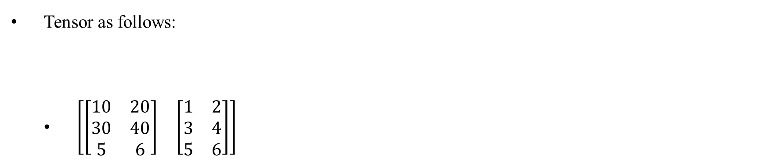
2. Introduction to Linear Algebra
Tensor
Tensor as follows:
$\left[\begin{matrix}\left[\begin{matrix}10 & 20 \\ 30 & 40 \\ 5 & 6\end{matrix}\right] & \left[\begin{matrix}1 & 2 \\ 3 & 4 \\ 5 & 6\end{matrix}\right]\end{matrix}\right]$

Slide 26
2. Introduction to Linear Algebra
Deep Learning Frameworks
Deep Learning Frameworks:
TensorFlow
PyTorch
Keras
Caffe
Theano

Slide 27
2. Introduction to Linear Algebra
TensorFlow
TensorFlow is a popular open-source deep learning framework developed by Google.
It was first released in 2015 and has since become one of the most widely used deep learning frameworks in the world.
TensorFlow is designed to make it easy to build and train machine learning models, particularly deep neural networks, by providing a flexible and scalable platform that can run on a variety of devices, including CPUs, GPUs, and TPUs
TensorFlow provides a variety of pre-built functions and modules that can be easily customized and combined to create complex neural network architectures.

Slide 28
2. Introduction to Linear Algebra
TensorFlow
One of the key features of TensorFlow is its ability to perform distributed training, which allows models to be trained across multiple devices and machines.
TensorFlow also supports a variety of programming languages, including Python, C++, Java, and more, making it accessible to developers with different programming backgrounds.
TensorFlow 2.x comes with Keras.
Keras is a popular high-level API for building neural networks and runs on top of TensorFlow and other deep learning frameworks.

Slide 29
Chapter 3
Artificial Neural Networks

Slide 30
3. Artificial Neural Networks
What is ANN?
An artificial neural network is composed of a large number of interconnected processing units, known as neurons, that work together to process input data and generate output predictions.
Each neuron receives input signals from other neurons or from the input data, performs a calculation, and passes the result to other neurons in the network.
The connections between neurons are modeled using weights, which are learned during the training process.

Slide 31
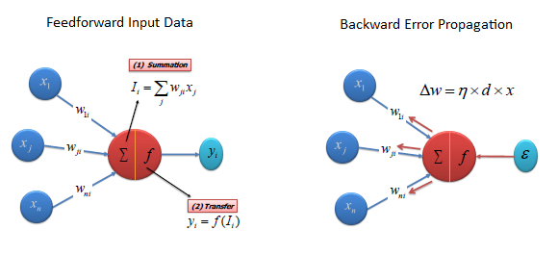
3. Artificial Neural Networks
What is ANN?
ANNs are mainly categorized as follows:
Feed forward NN
Feed backward NN
Source: https://www.saedsayad.com/images/ANN_4.png

Slide 32
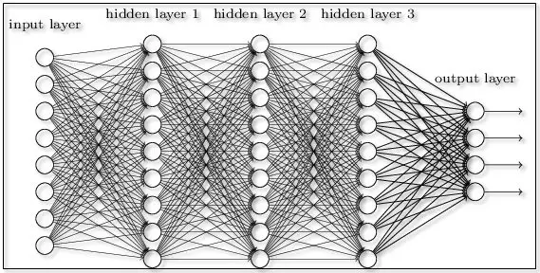
3. Artificial Neural Networks
Deep Neural Networks
Source: https://www.thewindowsclub.com/wp-content/uploads/2017/11/Neural-Network.jpg

Slide 33
3. Artificial Neural Networks
Activation Function
An activation function is a mathematical function that is applied to the output of each neuron in a neural network.
The activation function determines whether the neuron will be "activated" or "deactivated" based on the input it receives
It helps to introduce nonlinearity into the network, which is important for modeling complex relationships in the data.

Slide 34
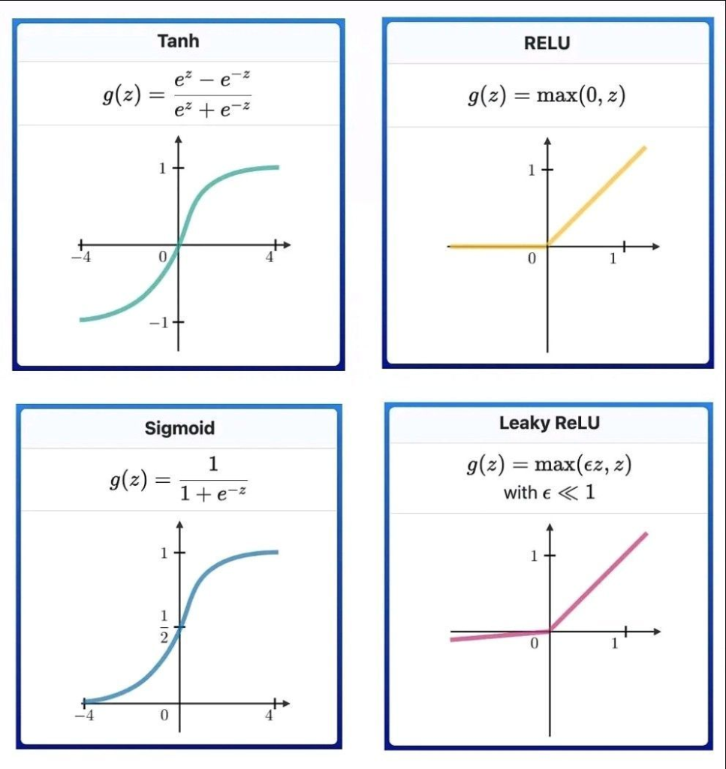
3. Artificial Neural Networks
Activation Function
Commonly used activation functions:
Linear
Sigmoid
Tanh
ReLU
Softmax
Source: https://ai-artificial-intelligence.webyes.com.br/wp-content/uploads/2022/09/image-1-967x1024.png

Slide 35
3. Artificial Neural Networks
Optimizers
Optimizers are algorithms used in artificial neural networks during the training phase to adjust the weights and biases of the network to minimize the loss/error.
Some commonly used optimizers are:
Gradient Descent:
It works by calculating the gradient of the loss function with respect to the weights and biases of the network, and adjusting the weights and biases in the opposite direction of the gradient to minimize the loss.
Stochastic Gradient Descent (SGD):
This optimizer is a variation of Gradient Descent that uses a random sample of the training data for each update. This can help speed up the training process for large datasets.

Slide 36
3. Artificial Neural Networks
Optimizers
Adagrad:
Adagrad is an optimizer that adapts the learning rate of each parameter based on the historical gradients. This can help improve the convergence rate of the model.
RMSprop:
RMSprop is an optimizer that uses a moving average of the squared gradients to adjust the learning rate. This can help prevent the learning rate from being too high or too low.
Adam:
Adam stands for Adaptive Moment Estimation is a popular optimizer that uses both the first and second moments of the gradients to adjust the learning rate during training.

Slide 37
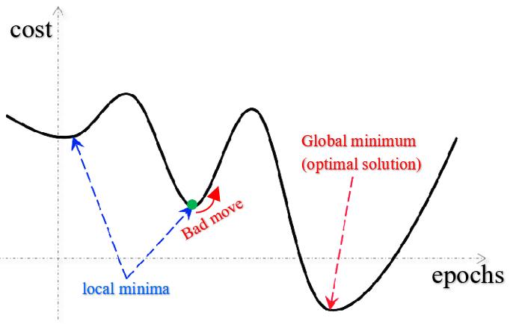
3. Artificial Neural Networks
Optimizers
Source: https://www.google.co.in/url?sa=i&url=https%3A%2F%2Fwww.researchgate.net%2Ffigure%2Flocal-minima-vs-global-minimum_fig2_341902041&psig=AOvVaw2WowYiTx4iaP_J3uJ3FE41&ust=1679052356647000&source=images&cd=vfe&ved=0CBAQjRxqFwoTCOCU04ar4P0CFQAAAAAdAAAAABAQ

Slide 38
3. Artificial Neural Networks
Optimizers
Source: https://mpopov.com/images/adam-animated.gif

Slide 39
3. Artificial Neural Networks
Optimizers
Source: https://user-images.githubusercontent.com/11681225/50016682-39742a80-000d-11e9-81da-ab0406610b9c.gif

Slide 40
3. Artificial Neural Networks
Simple ANN(Regression) Walkthrough
Simple ANN Model
# importing required libraries
import pandas as pd
import tensorflow as tf
from tensorflow.keras import Sequential
from tensorflow.keras.layers import Dense, Input
#reading data
ds = pd.read_csv('data/Advertisments.csv’)
x = ds.iloc[:,:-1].values
y = ds.iloc[:,-1].values

Slide 41
3. Artificial Neural Networks
Simple ANN(Regression) Walkthrough
Simple ANN Model
# Build ANN Architecture
model = Sequential([
Input(shape=(3,)),
Dense(1, activation='linear')
])
model.compile(optimizer='sgd', loss='msle', metrics=['acc', 'msle'])
model.fit(x_train, y_train, epochs=10)

Slide 42
3. Artificial Neural Networks
Simple ANN(Regression) Walkthrough
Simple ANN Model
# Displaying ANN Architecture
model.summary()
#Evaluating the model
model.evaluate(x, y)

Slide 43
3. Artificial Neural Networks
ANN(Binary Classification) Walkthrough
ANN BC Model
# importing required libraries
import pandas as pd
import tensorflow as tf
from tensorflow.keras import Sequential
from tensorflow.keras.layers import Dense, Input
#reading data
bank_ds = pd.read_csv('data/bank.csv', delimiter=';’)

Slide 44
3. Artificial Neural Networks
ANN(Binary Classification) Walkthrough
ANN BC Model
# Encoding categorical variables
from sklearn.preprocessing import LabelEncoder
le = LabelEncoder()
categorical_columns = ['job', 'marital', 'education', 'default', 'housing',
'loan', 'contact', 'month', 'poutcome', 'y']
for col in categorical_columns:
bank_ds[col] = le.fit_transform(bank_ds[col])

Slide 45
3. Artificial Neural Networks
ANN(Binary Classification) Walkthrough
ANN BC Model
# train, test split
from sklearn.model_selection import train_test_split
x = bank_ds.drop(['y'], axis=1).values
y = bank_ds['y'].values
x_train, x_test, y_train, y_test = train_test_split(x, y, test_size=0.25, random_state=0)

Slide 46
3. Artificial Neural Networks
ANN(Binary Classification) Walkthrough
ANN BC Model
# ANN Arch for Binary Classification
model_binary = Sequential()
model_binary.add(Dense(8, activation='relu’))
model_binary.add(Dense(1, activation='sigmoid')) #for binary class classification
model_binary.compile(optimizer='sgd', loss='binary_crossentropy', metrics=['accuracy'])
model_binary.fit(x_train, y_train, epochs=5, validation_data=(x_test, y_test))

Slide 47
3. Artificial Neural Networks
ANN(Binary Classification) Walkthrough
ANN BC Model
# Evaluating model
y_proba = model_binary.predict(x_test)
y_pred = []
for proba in y_proba:
if proba<0.5:
y_pred.append(0)
else:
y_pred.append(1)
accuracy_score(y_test, y_pred)

Slide 48
3. Artificial Neural Networks
ANN(Binary Classification) Walkthrough
ANN BC Model
# list(zip(y_proba, y_pred))
from sklearn.metrics import accuracy_score
accuracy_score(y_test, y_pred)

Slide 49
3. Artificial Neural Networks
ANN(Multi Class Classification) Walkthrough
ANN MC Model
iris_ds = datasets.load_iris()
x = iris_ds.data
y = iris_ds.target
from tensorflow.keras.utils import to_categorical
y_one_hot = to_categorical(y)

Slide 50
3. Artificial Neural Networks
ANN(Multi Class Classification) Walkthrough
ANN MC Model
# ANN Arch for Multi Class Classification
model_mc = Sequential()
model_mc.add(Dense(8, activation='relu'))
model_mc.add(Dense(4, activation='relu'))
model_mc.add(Dense(3, activation='softmax'))
model_mc.compile(optimizer='adam', loss='categorical_crossentropy', metrics=['accuracy'])
model_mc.fit(x, y_one_hot, epochs=3, validation_split=0.25)

Slide 51
3. Artificial Neural Networks
Image Classification using ANN Walkthrough
IC-ANN
import numpy as np
import pandas as pd
import tensorflow as tf
from matplotlib import pyplot as plt
from tensorflow.keras import datasets
from tensorflow.keras import Sequential
from tensorflow.keras.layers import Dense
from tensorflow.keras.utils import to_categorical

Slide 52
3. Artificial Neural Networks
Image Classification using ANN Walkthrough
IC-ANN
(x_train, y_train), (x_test, y_test) = mnist_ds = datasets.mnist.load_data()
x_train_x = x_train.reshape(x_train.shape[0], x_train.shape[1]*x_train.shape[2])
x_test_x = x_test.reshape(x_test.shape[0], x_test.shape[1]*x_test.shape[2])
y_train_c = to_categorical(y_train)
y_test_c = to_categorical(y_test)

Slide 53
3. Artificial Neural Networks
Image Classification using ANN Walkthrough
IC-ANN
model = Sequential()
model.add(Dense(250, activation='relu', input_shape=(28*28,)))
model.add(Dense(10, activation='softmax'))
model.compile(optimizer='sgd', loss='categorical_crossentropy', metrics=['acc'])
model.fit(x_train_x, y_train_c, epochs=5, batch_size=64, validation_data=(x_test_x, y_test_c))

Slide 54
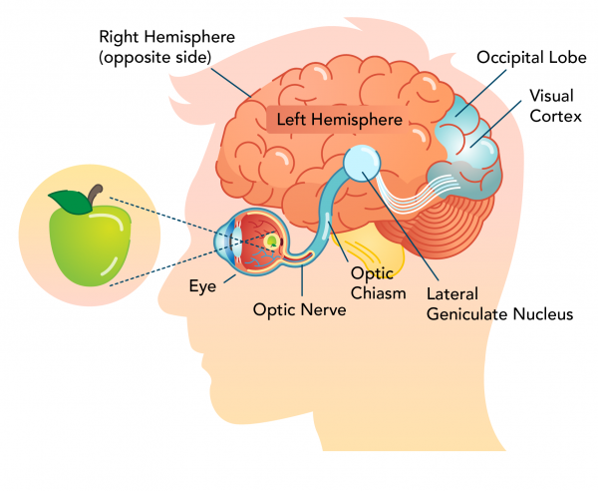
4. Convolutional Neural Networks
What is CNN?
Source: https://www.alphazoneeyeclinic.com/wp-content/uploads/2021/09/sight_and_brain_pathway.png

Slide 55
4. Convolutional Neural Networks
What is CNN?
CNN stands for Convolutional Neural Network.
It is commonly used for image and video analysis.
In a CNN, the input data is processed by a series of convolutional layers, which apply a set of learnable filters to the input in order to extract features that are important for the task at hand.
The output of the convolutional layers is then fed into a set of fully connected layers, which perform the final classification.
CNNs are widely used in various applications, such as image classification, object detection, face recognition, and many others.

Slide 56
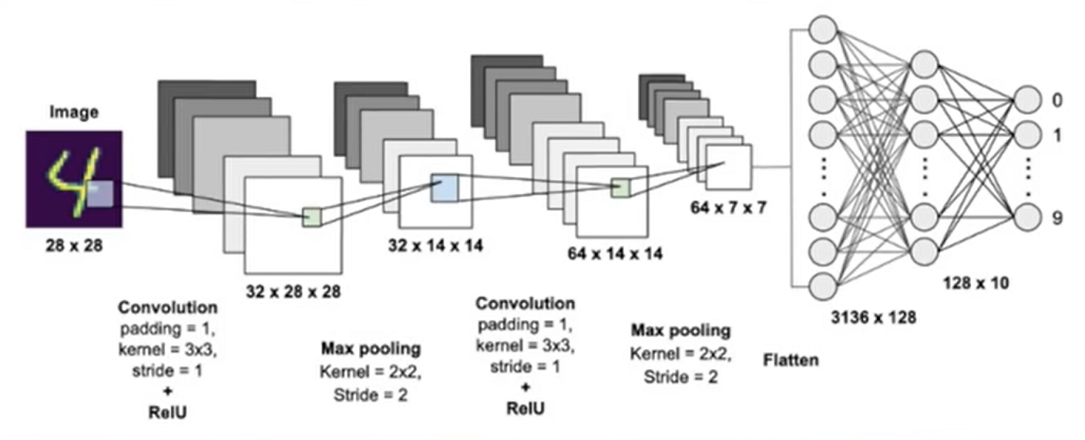
4. Convolutional Neural Networks
CNN Architecture

Slide 57
4. Convolutional Neural Networks
CNN Building Blocks
Kernel:
kernel is a set of learnable filters that are used to extract features from the input data.
Each filter is a small matrix of weights that slides over the input data, performing a convolution operation at each location.
The result of the convolution operation is a new feature map that highlights a particular pattern or feature of the input. For example, in an image recognition task, a kernel might be designed to detect horizontal or vertical edges in the image.
By applying multiple kernels to the input image, the CNN can learn to recognize more complex features such as corners, textures, and shapes.

Slide 58
4. Convolutional Neural Networks
CNN Building Blocks
Kernel:
The size and shape of the kernel are typically specified by the user, and they can vary depending on the task and the characteristics of the input data.
In general, larger kernels can capture more complex features but require more computation, while smaller kernels are faster to compute but may miss important details.

Slide 59
4. Convolutional Neural Networks
CNN Building Blocks
Stride:
Stride refers to the step size at which the kernel moves across the input data during the convolution operation.
When the stride is set to 1, the kernel moves one pixel at a time, producing a feature map with the same spatial dimensions as the input.
Using a larger stride can be useful in some cases, such as reducing the computational complexity of the network or increasing the receptive field of the kernels.

Slide 60
4. Convolutional Neural Networks
CNN Building Blocks
Padding:
Padding is a technique used to preserve the spatial dimensions of the input data during convolutional operations.
Padding adds extra pixels around the edges of the input, effectively increasing its size and allowing the kernel to slide over the edges of the input without losing information.
There are two types of padding commonly used in CNNs:
Valid padding: In this type of padding, no extra pixels are added to the edges of the input, so the output feature map is smaller than the input.
Same padding: In this type of padding, extra pixels are added symmetrically to the edges of the input, so that the output feature map has the same spatial dimensions as the input.

Slide 61
4. Convolutional Neural Networks
CNN Building Blocks
Pooling:
pooling is a technique used to down sample the feature maps obtained from convolutional layers.
The pooling operation is applied to each feature map independently and reduces its spatial dimensions while retaining important information.
Pooling Types:
Max pooling
Average pooling
It can reduce the computational complexity of the network by reducing the number of parameters in the subsequent layers.

Slide 62
4. Convolutional Neural Networks
CNN Building Blocks
Flatten:
Flatten refers to the process of converting a multidimensional feature map into a one-dimensional vector that can be fed into a fully connected layer for classification
The flatten operation reshapes the feature maps into a one-dimensional vector by concatenating all the elements of the feature maps along the channel and spatial dimensions.
For example, if the feature map has dimensions [height, width, channels], the flatten operation would reshape it into a vector of length [height * width * channels].

Slide 63
4. Convolutional Neural Networks
Image Classification using CNN Walkthrough
IC-CNN
import tensorflow as tf
from tensorflow.keras import datasets
from tensorflow.keras import Sequential
from tensorflow.keras.layers import Input, Dense, Flatten
from tensorflow.keras.utils import plot_model, to_categorical
from matplotlib import pyplot as plt

Slide 64
4. Convolutional Neural Networks
Image Classification using CNN Walkthrough
IC-CNN
(x_train, y_train), (x_test, y_test) = datasets.mnist.load_data()
# reshaping x_train into (60000, 784) and Y_train into one hot encoding
x_train_v = x_train.reshape(x_train.shape[0], x_train.shape[1]*x_train.shape[2])
y_train_c = to_categorical(y_train, num_classes=10)
# reshaping x_test into (10000, 784) and Y_test into one hot encoding
x_test_v = x_test.reshape(x_test.shape[0], x_test.shape[1]*x_test.shape[2])
y_test_c = to_categorical(y_test, num_classes=10)

Slide 65
4. Convolutional Neural Networks
Image Classification using CNN Walkthrough
IC-CNN
from tensorflow.keras.layers import Conv2D, MaxPool2D, Flatten, Dense
model_cnn = Sequential()
model_cnn.add(Conv2D(32, kernel_size=(3,3), input_shape=(28, 28, 1), activation='relu'))
model_cnn.add(MaxPool2D(pool_size=(2,2)))
model_cnn.add(Conv2D(64, kernel_size=(3,3), activation='relu'))
model_cnn.add(MaxPool2D(pool_size=(2,2)))

Slide 66
4. Convolutional Neural Networks
Image Classification using CNN Walkthrough
IC-CNN
model_cnn.add(Flatten())
model_cnn.add(Dense(500, activation='relu'))
model_cnn.add(Dense(250, activation='relu'))
model_cnn.add(Dense(10, activation='softmax'))
model_cnn.compile(optimizer='adam', loss='sparse_categorical_crossentropy', metrics=['accuracy'])
model_cnn.fit(x_train, y_train, epochs=5, validation_data=(x_test, y_test))

Slide 67
4. Convolutional Neural Networks
state-of-the-art CNN
state-of-the-art CNN networks that have achieved impressive results in various computer vision tasks.
Here are some examples:
LeNet-5
VGGNet
AlexNet
GoogLeNet
ResNet
Link for more data: https://keras.io/api/applications/
ImageNet Large Scale Visual Recognition Challenge (ILSVRC)

Slide 68
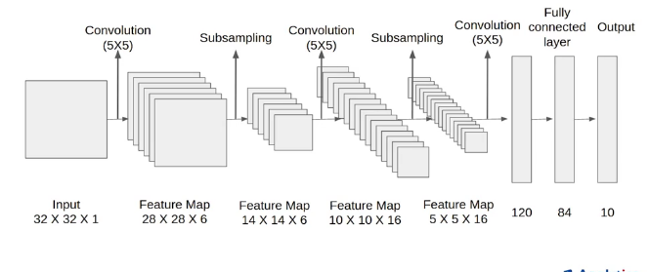
4. Convolutional Neural Networks
state-of-the-art CNN
LeNet-5
Image Source: https://cdn.analyticsvidhya.com/wp-content/uploads/2021/03/Screenshot-from-2021-03-18-12-52-17.png

Slide 69
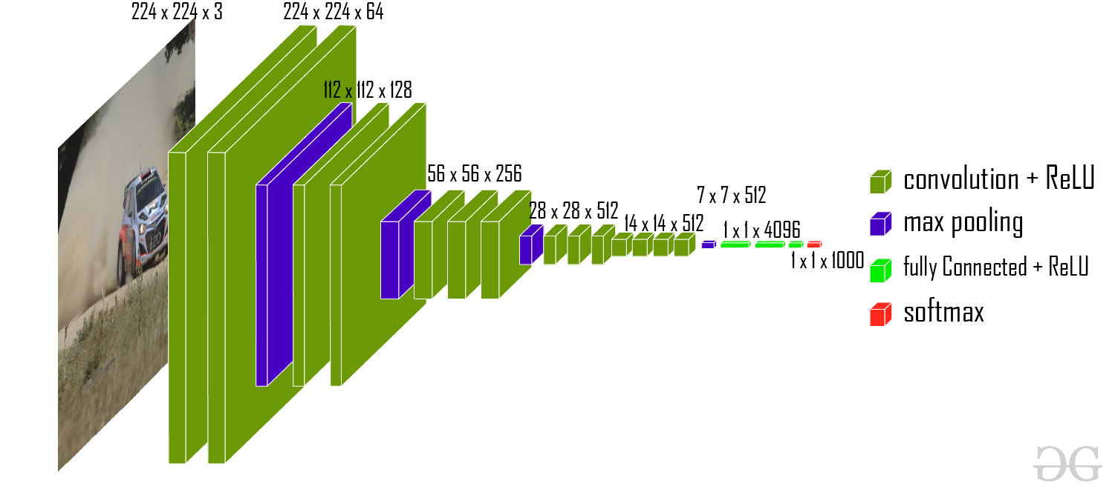
4. Convolutional Neural Networks
state-of-the-art CNN
VGGNet
(Visual Geometry Group)
Image Source: https://media.geeksforgeeks.org/wp-content/uploads/20200219152207/new41.jpg

Slide 70
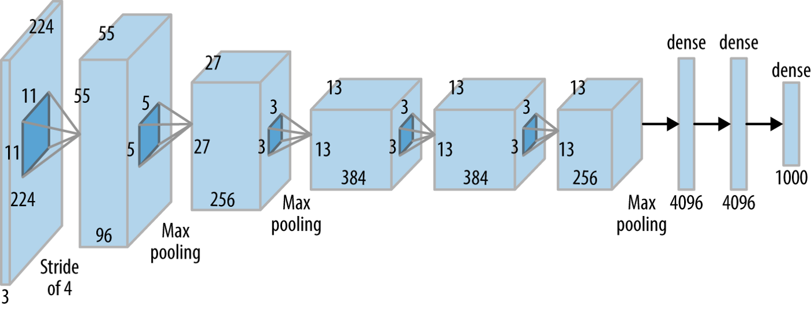
4. Convolutional Neural Networks
state-of-the-art CNN
AlexNet
Image Source: https://miro.medium.com/max/1400/1*bD_DMBtKwveuzIkQTwjKQQ.png

Slide 71
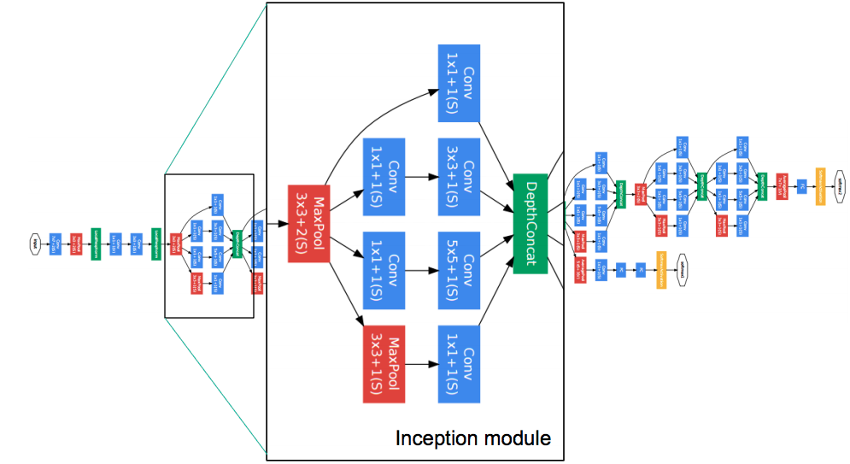
4. Convolutional Neural Networks
state-of-the-art CNN
GoogLeNet
Image Source: https://miro.medium.com/max/1400/1*66hY3zZTf0Lw2ItybiRxyg.png

Slide 72
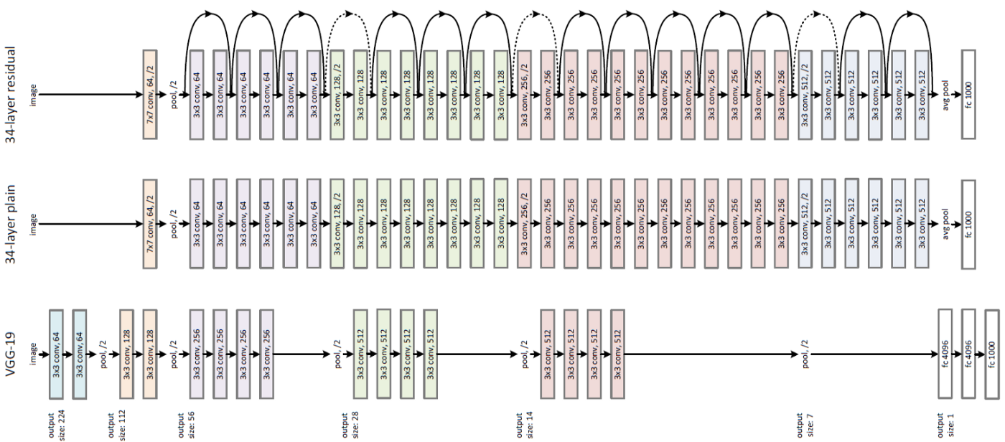
4. Convolutional Neural Networks
state-of-the-art CNN
ResNet
Image Source: https://miro.medium.com/max/1400/1*S3TlG0XpQZSIpoDIUCQ0RQ.jpeg

Slide 73
5. Transfer Learning
What is transfer learning?
It is a machine learning technique where a model trained on one task is re-purposed or adapted for a different but related task.
In transfer learning, the knowledge learned from one or more related tasks is transferred to a new task in order to improve performance and reduce the amount of data and training time required to train the new model.
The idea is that the knowledge learned from a related task can help the model learn more quickly and effectively on a new, similar task.

Slide 74
5. Transfer Learning
Image Classification using Transfer Learning Walkthrough
IC-TR-VGG16
import tensorflow as tf
import tensorflow_datasets as tfds
from keras.utils import to_categorical
(train_ds, train_labels), (test_ds, test_labels) = tfds.load("tf_flowers",
split=["train[:70%]", "train[70%:]"], ## Train test split
batch_size=-1,
as_supervised=True, # Include labels
)

Slide 75
5. Transfer Learning
Image Classification using Transfer Learning Walkthrough
IC-TR-VGG16
train_ds = tf.image.resize(train_ds, (150, 150))
test_ds = tf.image.resize(test_ds, (150, 150))
train_labels = to_categorical(train_labels, num_classes=5)
test_labels = to_categorical(test_labels, num_classes=5)
from keras.applications.vgg16 import VGG16
from keras.applications.vgg16 import preprocess_input
base_model = VGG16(weights="imagenet", include_top=False, input_shape=train_ds[0].shape)

Slide 76
5. Transfer Learning
Image Classification using Transfer Learning Walkthrough
IC-TR-VGG16
base_model.trainable = False
train_ds = preprocess_input(train_ds)
test_ds = preprocess_input(test_ds)
from keras import layers, models
flatten_layer = layers.Flatten()
dense_layer_1 = layers.Dense(50, activation='relu')
dense_layer_2 = layers.Dense(20, activation='relu')
output_layer = layers.Dense(5, activation='softmax')

Slide 77
5. Transfer Learning
Image Classification using Transfer Learning Walkthrough
IC-TR-VGG16
model = models.Sequential([
base_model,
flatten_layer,
dense_layer_1,
dense_layer_2,
output_layer
])
from keras.callbacks import EarlyStopping

Slide 78
5. Transfer Learning
Image Classification using Transfer Learning Walkthrough
IC-TR-VGG16
model.compile(optimizer='adam', loss='categorical_crossentropy', metrics=['accuracy'])
epochs = 2
batch_size = 32
es = EarlyStopping(monitor='val_accuracy', min_delta=0.5, patience=3)
model.fit(train_ds, train_labels, epochs=epochs, validation_split=0.2, batch_size=batch_size, callbacks=[es])

Slide 79
6. Computer Vision
What is computer vision?
Computer vision is a field of study that focuses on enabling computers to interpret and understand visual data from the world around them.
It involves the use of various techniques and algorithms to analyze, process, and interpret images and videos in order to extract useful information.
Computer vision has a wide range of applications in various industries, such as healthcare, entertainment, automotive, security, and more.
Some examples include facial recognition, object detection, autonomous vehicles, medical imaging, and augmented reality.

Slide 80
6. Computer Vision
Computer Vision Tasks
Image Classification:
This task involves assigning a label or a category to an image. For example, identifying whether an image contains a cat or a dog.
Object Detection:
This task involves identifying and localizing objects within an image. Object detection is used in various applications such as self-driving cars, and video surveillance.
Image Segmentation:
This task involves dividing an image into different segments or regions based on various attributes such as color, texture, or shape.

Slide 81
6. Computer Vision
OpenCV
OpenCV is an open-source computer vision library that provides a wide range of tools and algorithms for image and video processing.
It was originally developed by Intel in 1999 and has since been maintained by a community of developers.
OpenCV offers various features and functions for image and video processing, including image and video capture, image filtering, feature detection, object tracking, and machine learning.
It is written in C++, but also provides interfaces for Python, Java, and other programming languages.

Slide 82
6. Computer Vision
OpenCV
Installing OpenCV
pip install opencv-python
Importing OpenCV
import cv2
print(cv2.__version__)

Slide 83
6. Computer Vision
OpenCV Important Functions
cv2.imread():
It is used to read an image from a file and convert it into a NumPy array.
cv2.imshow():
It is used to display an image in a window. It takes the image data as input and displays it on the screen.
cv2.cvtColor():
It is used to convert an image from one color space to another. It takes the image data and the desired color space as input and returns the converted image.

Slide 84
6. Computer Vision
OpenCV Important Functions
cv2.VideoCapture():
It is used to capture video from a camera or a file. It takes the camera index or the file path as input and returns a VideoCapture object that can be used to read frames from the video stream.
cv2.rectangle():
It is used to draw a rectangle on an image. It takes the image data, the position of the top-left corner, the position of the bottom-right corner, and the color and thickness of the rectangle as input.

Slide 85
6. Computer Vision
OpenCV Important Functions
cv2.putText():
It is used to draw text on an image. It takes the image data, the text to be drawn, the position of the text, the font type and size, and the color and thickness of the text as input.
cv2.waitKey()
This function waits for a specified delay for a keyboard event to occur. It takes an integer argument representing the delay in milliseconds as input, and returns the key code of the pressed key as output.

Slide 86
6. Computer Vision
Reading and Displaying an Image
import cv2
# Reading an image
img = cv2.imread('image.jpg')
# Displaying an image in a window
cv2.imshow('image', img)
# Close the window after pressing q
if cv2.waitKey(0) && 0xFF==ord(‘q’):
cv2.destroyAllWindows()

Slide 87
6. Computer Vision
Drawing Shapes on Image
import cv2
# Reading an image
img = cv2.imread('image.jpg')
# Drawing a rectangle on an image
cv2.rectangle(img, (100, 100), (200, 200), (0, 255, 0), 2)
# Drawing a rectangle on an image
cv2.line(img, (100, 100), (200, 200), (255, 0, 0), 2)

Slide 88
6. Computer Vision
Drawing Shapes on Image
# Drawing text on an image
cv2.putText(img, ‘OpenCV....!', (50, 50), cv2.FONT_HERSHEY_SIMPLEX, 1, (0, 0, 255), 2)
# Displaying the image with rectangle and text
cv2.imshow(‘Graphics', img)
# Close the window after pressing q
if cv2.waitKey(0) && 0xFF==ord(‘q’):
cv2.destroyAllWindows()

Slide 89
6. Computer Vision
Reading and Displaying Video Stream From Camera
import cv2
# Capturing video from a camera
vid = cv2.VideoCapture(0)
while(True):
# Reading a frame from the video stream
ret, frame = vid.read()
# Displaying the frame in a window
cv2.imshow('frame', frame)

Slide 90
6. Computer Vision
Reading and Displaying a Video
# Exiting on pressing the 'q' key
if cv2.waitKey(1) & 0xFF == ord('q’):
vid.release()
cv2.destroyAllWindows()
break

Slide 91
7. Natural Language processing
Natural Language processing
Natural Language Processing (NLP) is a branch of AI and computational linguistics that focuses on the interactions between humans and computers using natural language.
It involves the development of algorithms and models to enable computers to understand, interpret, and generate human language such as English, Hindi and more.
NLP tasks:
Language understanding
Language generation
Language translation
Sentiment analysis.

Slide 92
7. Natural Language processing
Natural Language processing
NLP applications are chatbots, virtual assistants, search engines, and language translation services.
NLP models typically involve some form of machine learning, such as supervised or unsupervised learning, to train the models on large datasets of text data.
These models can be based on various techniques such as rule-based systems, statistical models, or deep learning models such as recurrent neural networks (RNNs) or transformers.
As the demand for natural language processing applications continues to grow, there is a need for continued research and development to improve the accuracy, and applicability of NLP models.

Slide 93
7. Natural Language processing
NLP Terminology
Token
Tokenization
Stemming
Lemmatization
Part-of-speech (POS) tagging
Named entity recognition (NER)
Sentiment analysis
Language modeling
Machine translation
Information retrieval
Text classification

Slide 94
7. Natural Language processing
NLP Terminology
Token:
Token is an individual unit of text that has been separated or segmented from a larger body of text.
Tokenization:
The process of splitting a text into individual units or tokens, such as words or sub words, for further analysis.
Stemming:
A process of reducing words to their base or root form, such as converting "walking" to "walk".

Slide 95
7. Natural Language processing
NLP Terminology
Lemmatization:
A process of reducing words to their base or dictionary form, such as converting "am", "are", and "is" to "be".
Part-of-speech (POS) tagging:
A process of assigning grammatical tags to words in a sentence, such as whether a word is a noun, verb, adjective, or adverb.
Named entity recognition (NER):
A process of identifying and categorizing named entities, such as people, organizations, and locations, in text.

Slide 96
7. Natural Language processing
NLP Terminology
Sentiment analysis:
A process of determining the sentiment or emotional tone of a text, such as whether a movie review is positive or negative.
Language modeling:
A process of predicting the probability of a sequence of words in a language, which is used for tasks such as speech recognition and machine translation.
Machine translation:
A process of automatically translating text from one language to another.

Slide 97
7. Natural Language processing
NLP Terminology
Information retrieval:
A process of retrieving relevant information from a large collection of documents or text, such as using a search engine to find web pages.
Text classification:
A process of categorizing text into predefined categories, such as classifying news articles into topics like sports, politics, and entertainment.

Slide 98
7. Natural Language processing
Vectorization
Vectorization is the process of converting text data into numerical vectors, which can be used as input for machine learning algorithms.
Various techniques for vectorization:
Bag-of-words
Term frequency-inverse document frequency
Word embeddings
Character embeddings

Slide 99
7. Natural Language processing
Vectorization
Bag-of-words:
The bag-of-words model represents text as a collection of words and their frequency of occurrence in a document.
Each word is treated as a separate feature, and the resulting vector represents the frequency of each word in the document.
Term frequency-inverse document frequency (TF-IDF):
TF-IDF is a statistical measure that reflects the importance of a word in a document.
It is calculated as the product of the term frequency (how often a word appears in a document) and the inverse document frequency (how often the word appears in all documents in the corpus).

Slide 100
7. Natural Language processing
Vectorization
Word embeddings:
Word embeddings are a type of dense vector representation of words, where each word is represented by a vector of fixed dimensionality.
Word embeddings capture the semantic meaning of words and their relationships with other words in the vocabulary.
Character embeddings:
Character embeddings are similar to word embeddings, but they represent each character in a word as a vector.
Character embeddings are useful for capturing morphological information, such as prefixes and suffixes, that can help with tasks such as named entity recognition.

Slide 101
7. Natural Language processing
NLP Packages
Natural Language Toolkit (NLTK):
NLTK is a comprehensive library for NLP in Python. It provides modules for tokenization, stemming, lemmatization, POS tagging, and more.
Gensim:
Gensim is a library for topic modeling and similarity analysis of text.
It provides modules for text processing, document similarity analysis, and topic modeling.

Slide 102
8. RNN
What is RNN?
RNN stands for Recurrent Neural Network
It is a type of neural network architecture designed for processing sequential data, such speech, and natural language text.
RNNs can process sequences of variable lengths and maintain a memory of the past inputs they have processed.
The key idea behind RNNs is the use of hidden states, which are updated at each time step as the network processes the input sequence.

Slide 103
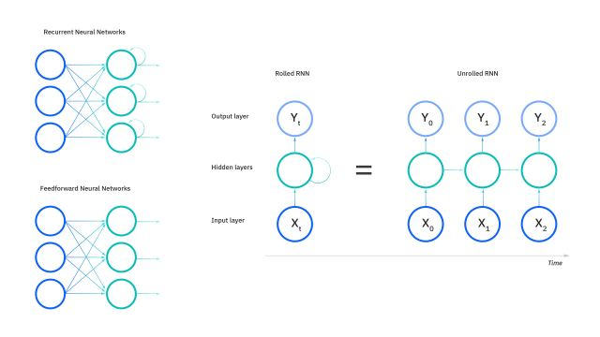
8. RNN
RNN
Source: https://www.ibm.com/content/dam/connectedassets-adobe-cms/worldwide-content/cdp/cf/ul/g/27/80/what-are-recurrent-neural-networks-combined.component.simple-narrative-xl.ts=1671203207332.jpg/content/adobe-cms/us/en/topics/recurrent-neural-networks/jcr:content/root/table_of_contents/intro/simple_narrative/image

Slide 104
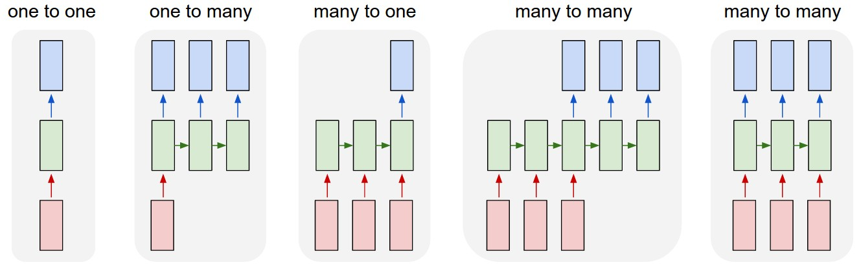
8. RNN
RNN Types
Source: https://i.stack.imgur.com/6VAOt.jpg

Slide 105
8. RNN
Limitations of RNN
One limitation of RNNs is the vanishing gradient problem, which makes it difficult for the network to propagate gradients over long sequences.
To solve this problem, various variants of RNNs have been proposed:
LSTM (Long Short-Term Memory
GRU (Gated Recurrent Unit)
Which use different mechanisms for updating the hidden state and maintaining memory over long sequences

Slide 106
8. RNN
LSTM & GRU
LSTM has three gates:
input gate:
It controls how much new information is added to the memory cell
output gate
It controls how much of the memory cell is used to produce the output
forget gate.
It controls how much old information is removed from the memory cell
GRU has only two gates:
reset gate
It controls how much of the previous memory state is forgotten
update gate.
It controls how much of the new input is added to the current memory state.

Slide 107
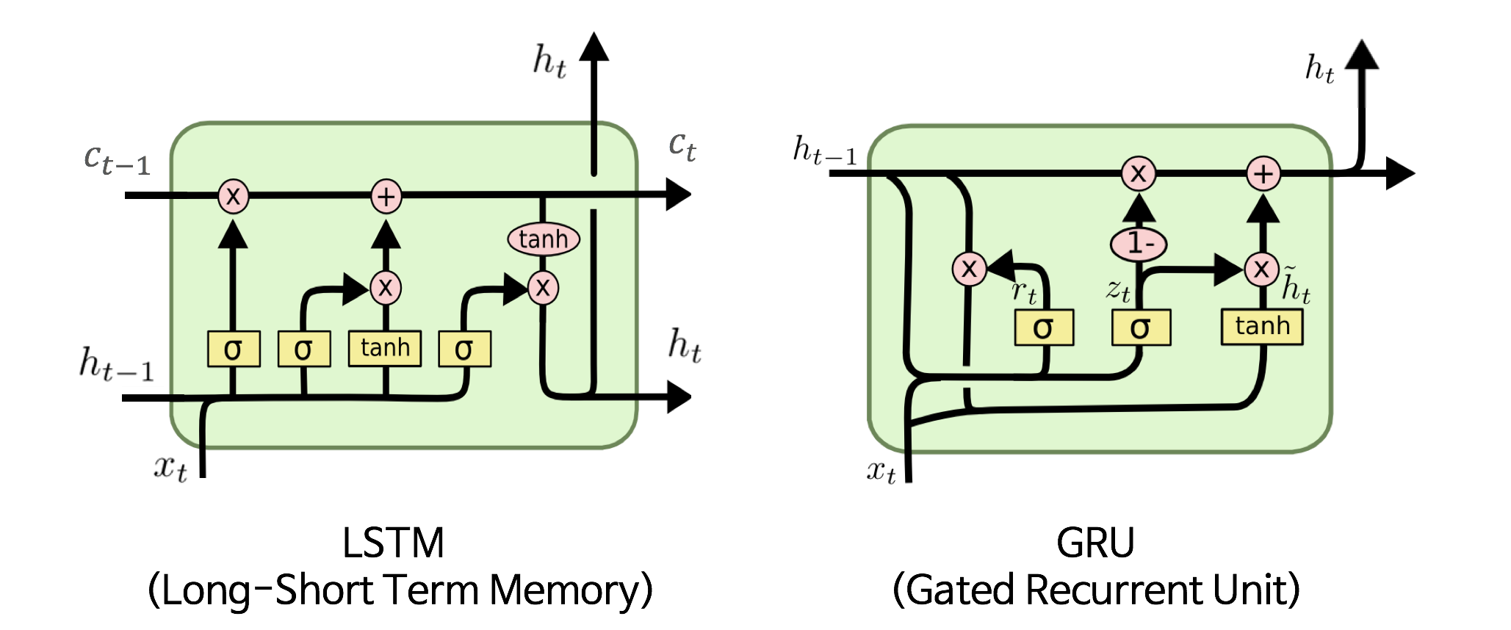
8. RNN
RNN Types
Source: https://user-images.githubusercontent.com/15166794/39033683-3020ce04-44ae-11e8-821f-1a9652ff5025.png

Slide 108
8. RNN
Sentiment Analysis Walkthrough
SA-LSTM/GRU
from tensorflow.keras.datasets import imdb
from tensorflow.keras.preprocessing.sequence import pad_sequences
(x_train, y_train), (x_test, y_test) = imdb.load_data(num_words=10000)
word_index = imdb.get_word_index()
MAX_LEN = 256
x_train = pad_sequences(x_train, maxlen=MAX_LEN, value=word_index['the'], padding='post’)
x_test = pad_sequences(x_test, maxlen=MAX_LEN, value=word_index['the'], padding='post')

Slide 109
8. RNN
Sentiment Analysis Walkthrough
SA-LSTM/GRU
from tensorflow.keras.models import Sequential
from tensorflow.keras.layers import Embedding, LSTM, GRU, Dense
lstm_model = Sequential()
lstm_model.add(Embedding(10000, 128, input_shape=(MAX_LEN, )))
lstm_model.add(LSTM(64, activation='tanh'))
lstm_model.add(Dense(1, activation='sigmoid’))
lstm_model.compile(optimizer='adam', loss='binary_crossentropy', metrics=['accuracy'])
lstm_model.fit(x_train, y_train, epochs=2, validation_data=(x_test, y_test), batch_size=128)

Slide 110
8. RNN
Sentiment Analysis Walkthrough
SA-LSTM/GRU
gru_model = Sequential()
gru_model.add(Embedding(10000, 128, input_shape=(MAX_LEN, )))
gru_model.add(GRU(64, activation='tanh'))
gru_model.add(Dense(1, activation='sigmoid'))
gru_model.compile(optimizer='adam', loss='binary_crossentropy', metrics=['accuracy'])
gru_model.fit(x_train, y_train, epochs=2, batch_size=128, validation_data=(x_test, y_test))

